Slide 1

Introduction to Machine Learning with H2O
Jo-fai (Joe) Chow
Data Scientist
joe@h2o.ai
(draft version 0.3)
Paris Machine Learning Meetup
Murex
21st September, 2016

Slide 2
About Me: Civil Engineer → Data Scientist
2005 - 2015
Water Engineer
Consultant for Utilities
EngD Research
Machine learning + Water Engineering
Discovered H2O in 2014!
2015 - Present
Data Scientist
Virgin Media (UK)
Domino Data Lab (US)
H2O.ai (US)
Why? Long story – see bit.ly/joe_h2o_talk2

Slide 3
Agenda
This Talk (30 mins)
About H2O.ai
Demos
Web & R Interface
Why H2O?
Our Community
Our Customers
What’s Next?
New developments
Second Talk (30 mins)
Deep Water
Demos
H2O + mxnet
H2O + TensorFlow
Third Talk (45 mins)
H2O + Spark = Sparkling Water
Demos
H2O + Spark MLlib

Slide 4
About H2O.ai

Slide 5
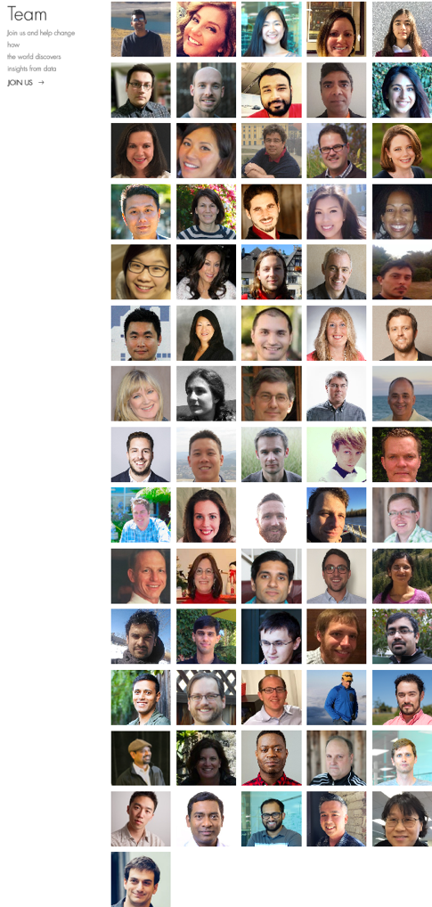
About H2O.ai
H2O.ai, the Company
Team: 80 (71 shown)
Founded in 2012
HQ: Mountain View, California
H2O, the Platform
Open Source (Apache 2.0)
R, Python, Scala, Java and Web Interfaces
Distributed Algorithms that Scale to Big Data
Works with Laptop, Hadoop & Spark
Jakub
(Kuba)
Joe
Notes:
Team is growing rapidly
Based in Mountain View – I am the only guy in UK/Europe
VC: $34M in total

Slide 6
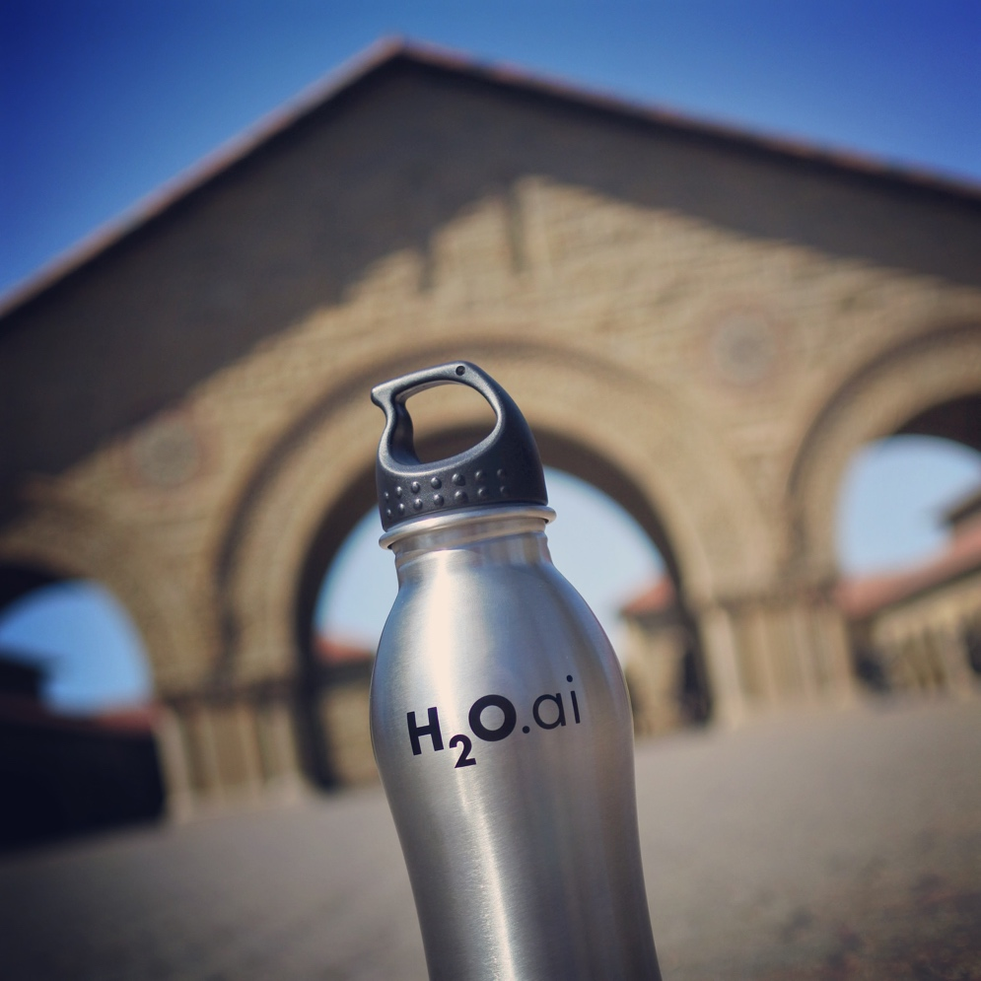
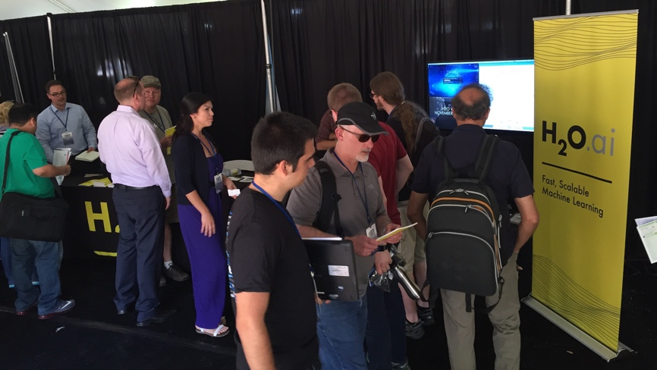
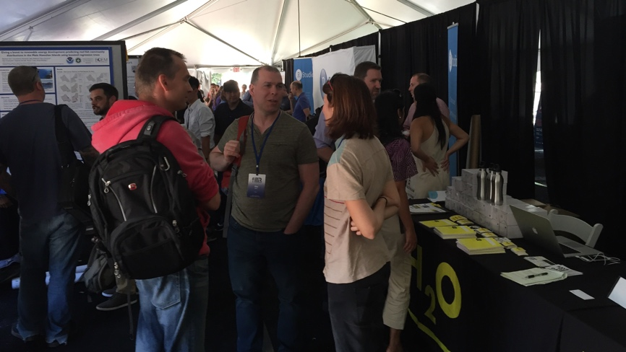
H2O.ai & Stanford University
useR! 2016 Conference at Stanford

Slide 7


Scientific Advisory Council

Slide 8
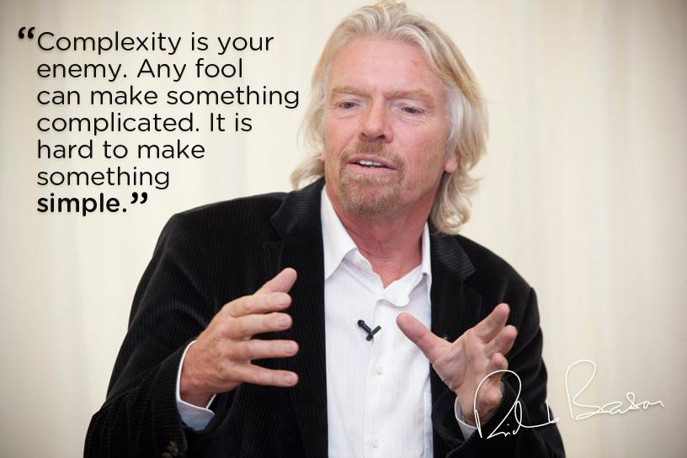
H2O’s Mission
Machine Learning for EVERYONE
Photo credit: Virgin Media

Slide 9







H2O Platform Overview
Core algorithms written in high performance Java.
Fast, distributed and scalable.
APIs available in R, Python, Scala, REST/JSON and web.
Works with laptop, Hadoop and Spark

Slide 10
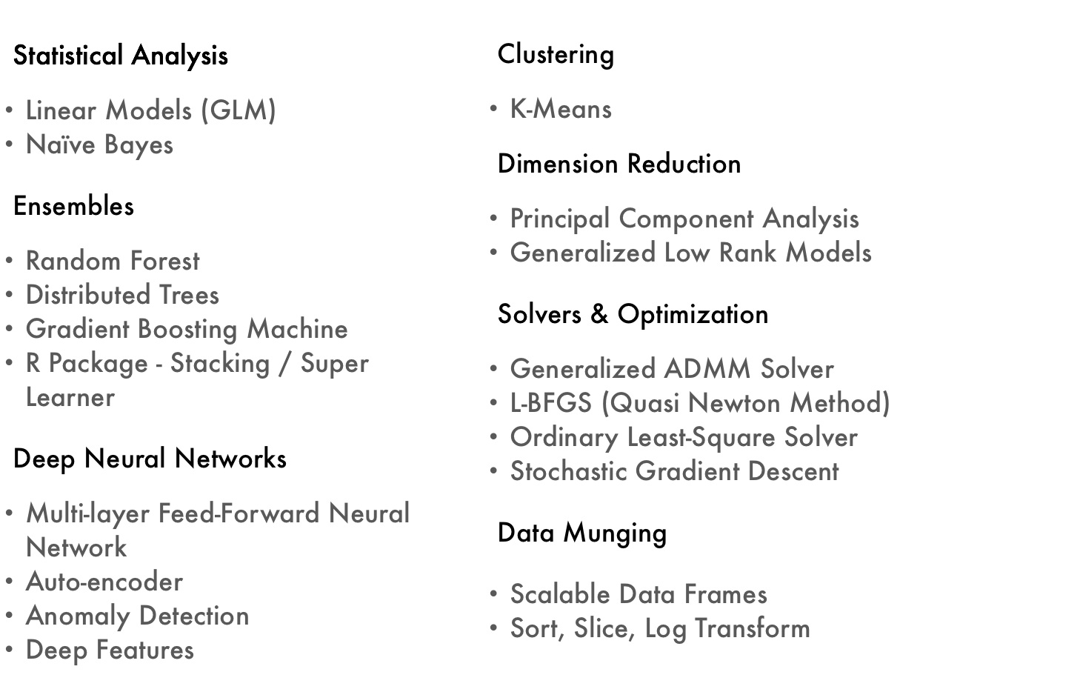
Current Algorithm Overview
Joe’s Strata Hadoop
London Talk
bit.ly/joe_h2o_talk4
Web & R
Demos
Joe’s LondonR Talk
bit.ly/joe_h2o_talk3

Slide 11
H2O Demos

Slide 12
H2O Demos
Demo 1: Web Interface
Public dataset
Import data
Explore data
Build & evaluate models
Make predictions
Demo 2: R Interface
Same process using R script

Slide 13
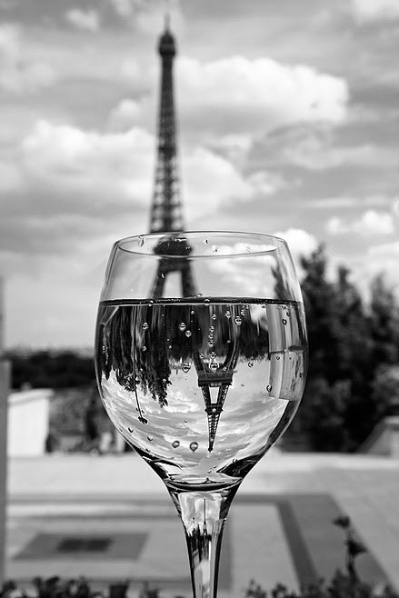
Public Dataset – Wine Quality
Photo credit: 28.media.tumblr.com

Slide 14
Public Dataset – Wine Quality
11 Features
Characteristics of wine
Acidity, Sugar, pH ... etc.
1 Output
Quality (0 – 10)
Classification / Regression
4898 Records
White wine
UCI Machine Learning Repository
http://archive.ics.uci.edu/ml/datasets/Wine+Quality
CSV
http://archive.ics.uci.edu/ml/machine-learning-databases/wine-quality/winequality-white.csv

Slide 15
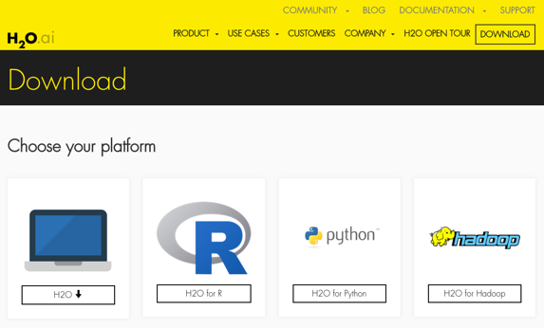
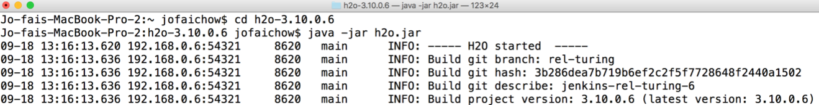
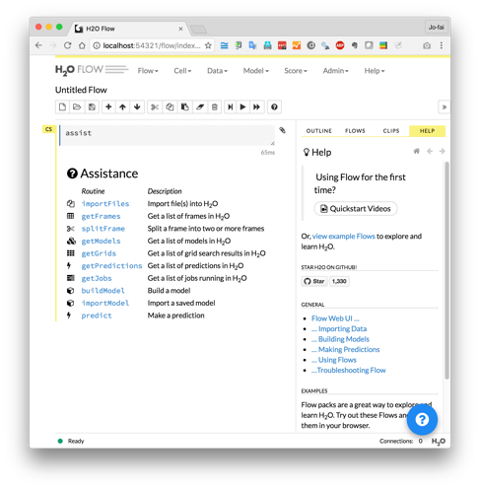
H2O Flow (Web Interface) Demo
Download and unzip jar from www.h2o.ai
In terminal:
java -jar h2o.jar
Web browser:
localhost:54321

Slide 16
H2O Web Interface – Live Demo
For online audience
Go to this GitHub repo bit.ly/h2o_paris_1
Go to sub-folder demo_01_flow
Following the procedures in README.md
Screenshot here

Slide 17
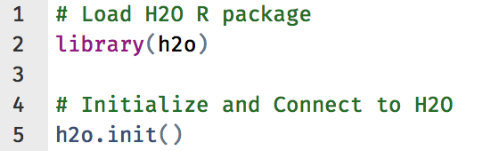
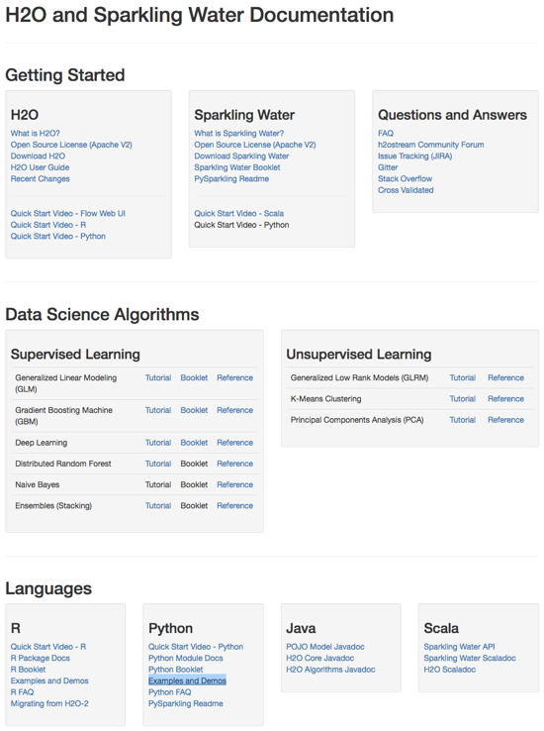
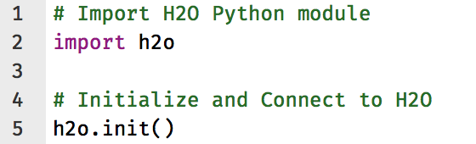
H2O Interfaces – R, Python & Others
R
Python
Resources - docs.h2o.ai

Slide 18
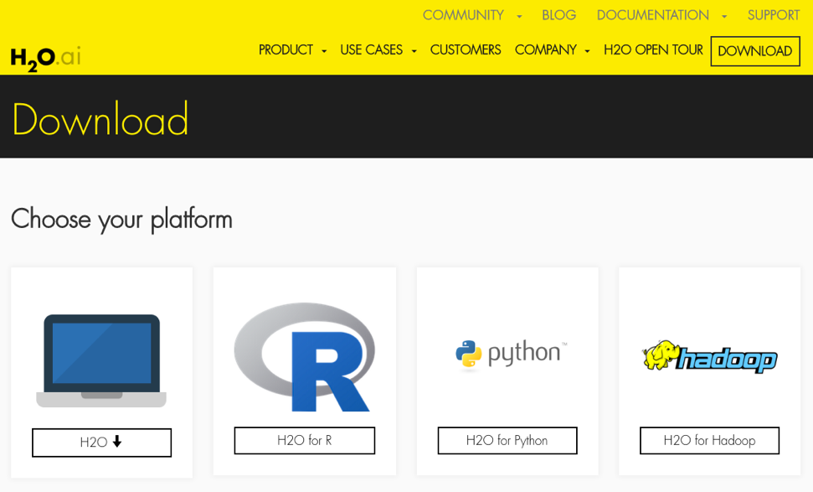
H2O R Package Demo
Install latest stable
Recommended method
See instructions on webpage
Install from CRAN
install.packages(”h2o”)

Slide 19
H2O R Interface – Live Demo
For online audience
Go to this GitHub repo bit.ly/h2o_paris_1
Go to sub-folder demo_02_r
Download and run R scripts.
Screenshot here

Slide 20
More Advanced Topics
Hyperparameters Optimization
Model Stacking
Export Plain Old Java Object (POJO)
Resources:
Budapest H2O Workshop
Other links

Slide 21
Why H2O?

Slide 22
AI is Eating the World

Slide 23
Machine Learning for Everyone

Slide 24
Our Users & Customers

Slide 25

Szilard Pafka – ‎Chief Data Scientist at Epoch
Sziland’s talks / blog posts about H2O:
ML Benchmark
Intro to ML with H2O
Tweets

Slide 26
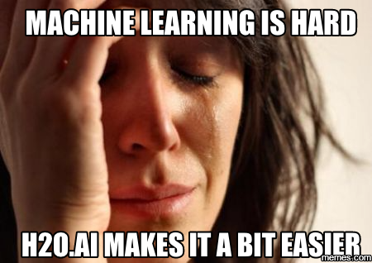
Szilard Pafka – Why H2O?
Szilard’s Summary Slide

Slide 27
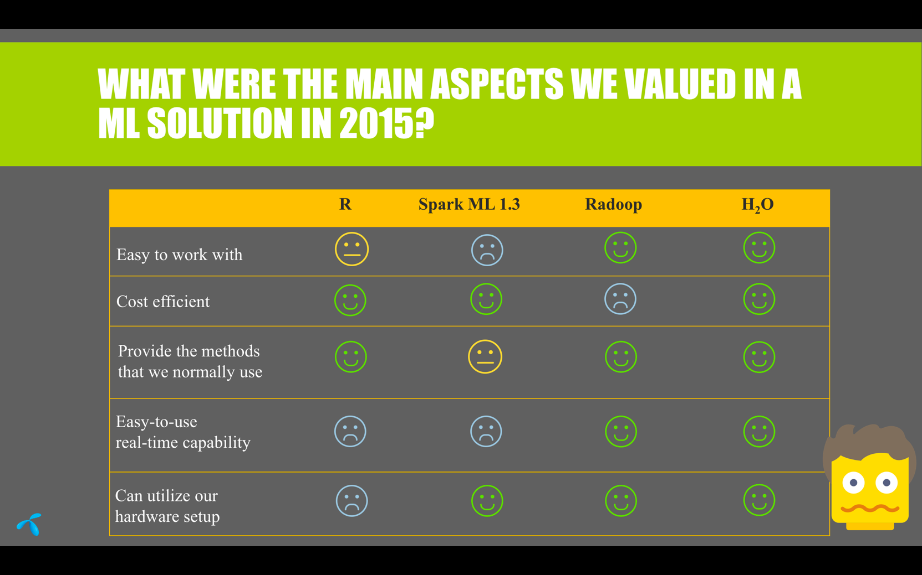
Telenor (Telecom in Hungary) – Why H2O?

Slide 28
H2O for Kaggle Competitions

Slide 29
Wit – Why H2O?
His quotes

Slide 30

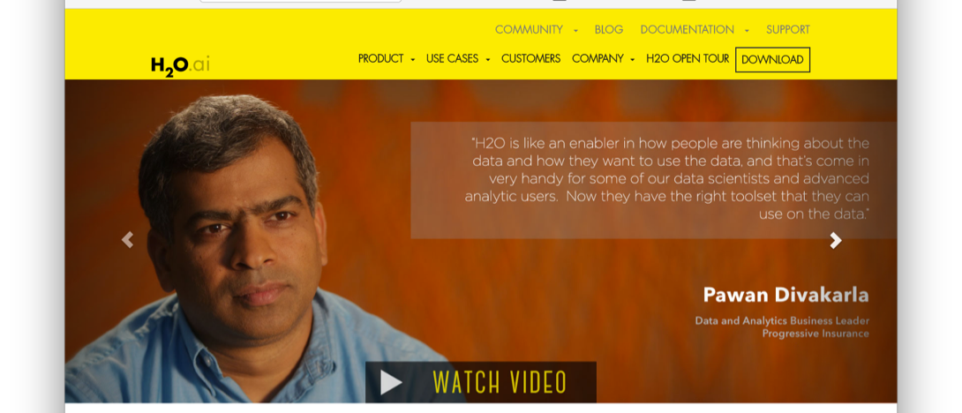
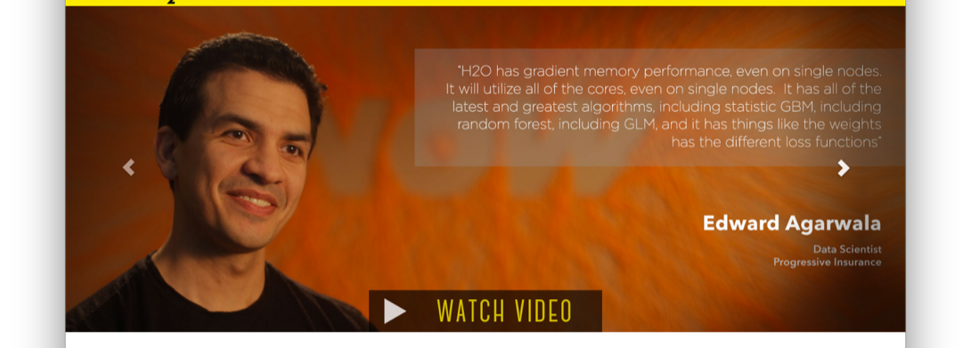
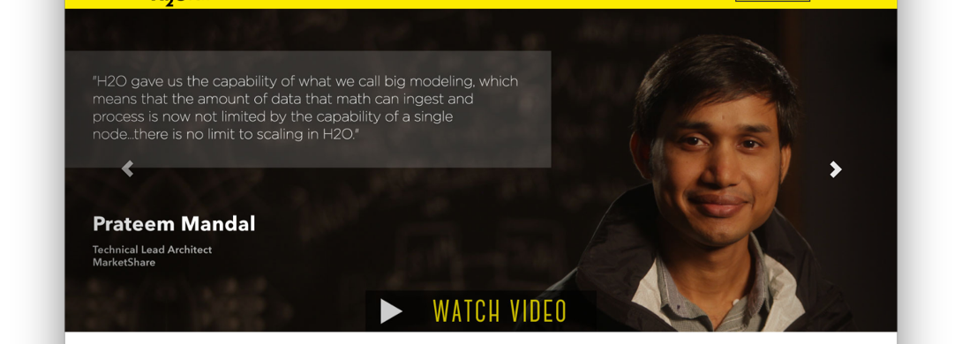
H2O Customers
Check out the videos - www.h2o.ai

Slide 31
What’s Next?

Slide 32
Recap: H2O’s Mission
Machine Learning for EVERYONE
Photo credit: Virgin Media

Slide 33
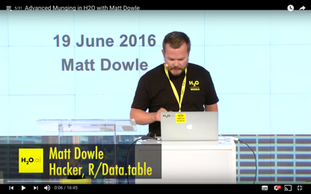
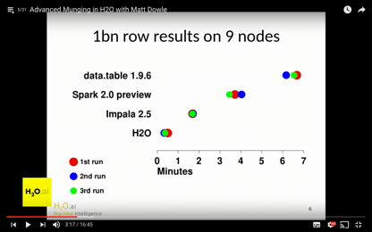
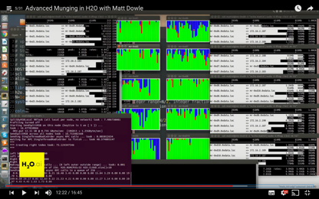
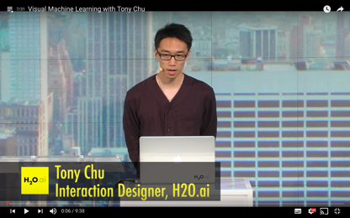
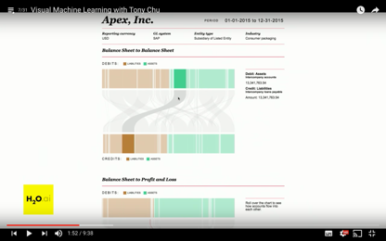
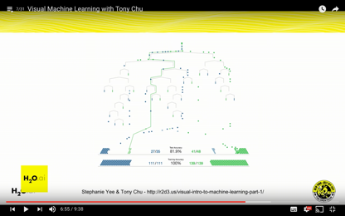
H2O is Evolving
H2O Open Tour NYC YouTube Playlist
Advanced data munging
Visual ML
Deep Water (2nd talk)
Sparkling Water (3rd talk)
Steam
New data science platform

Slide 34
Thanks!
Paris ML Meetup
Jiqiong (Ji) Qiu
Franck Bardol
Igor Carron
Murex
Slides & Code
bit.ly/h2o_paris_1
Contact
joe@h2o.ai
@matlabulous
github.com/woobe

